Slide 1
HORMONE ACTION AND SIGNAL TRANSDUCTION
DR AMINA TARIQ
BIOCHEMISTRY

Slide 2
Survival of a multicellular organism depends on their ability to adapt to the constantly changing environment.
Intercellular communication mechanisms are necessary for this adaptation.
Nervous system and endocrine system provide this intercellular, organism- wide communication.

Slide 3
Word hormone is a Greek term that means to arouse to activity.
Hormone is defined as a substance that is synthesized in one organ and transported by the circulatory system to act on another tissue.

Slide 4
Hormones are chemically diverse
Cholesterol derived Hormones- Glucocorticoids, mineralocorticoids, estrogens, Progestins, 1,25 (OH)₂-D₃ .
Steroid hormone can be the precursor of another hormone e.g. Progesterone is the precursor of Mineralocorticoids, Glucocorticoids, and androgens.

Slide 5
Testosterone is then an obligatory intermediate in the biosynthesis of estradiol and dihydrotestosterone.
The final product s determined by the cell type and set of enzymes that present.

Slide 6
The amino acid tyrosine is the precursor of catecholamines and of thyroid hormones.
Thyroid hormones require Iodine addition for their bioactivity.
Many hormones are polypeptides e.g. ACTH(39 AA), TRH(tripeptide), PTH (84 AA)and growth hormone(191 AA).

Slide 7
Insulin has AB chains formed from 21 and 30 amino acids.
FSH,LH,TSH,CG are glycoproteins. The alpha chain is identical in all these hormones and the beta chain is specific.

Slide 8
Some hormones are synthesized in the final form and secreted immediately. e.g. Cholesterol derived hormones.
Other hormones are synthesized in the final form and stored in the producing cells e.g. Catecholamines.

Slide 9
Some hormones are synthesized from their precursor molecules, processed and then secreted upon a physiologic response e.g. Insulin.
Others are converted to active forms from precursor molecules in the periphery e.g. T₃ and DHT.

Slide 10
BIOMEDICAL IMPORTANCE
Homeostatic adaptations by an organism are in large part accomplished through alterations of the activity and amount of proteins.
Hormones provide a major means of facilitating these changes.
Hormone –receptor interaction occurs that results in the generation of an intracellular signal.

Slide 11
Intracellular signal can either regulate the activity of a select set of genes, leading to alteration in the amount of certain proteins in the target cell.
Or this signal affect the activity of specific proteins including enzymes, transporter or channel proteins.

Slide 12
The signal can influence the location of proteins in the cell and can affect their general processes such as: Protein synthesis, cell growth and replication through effects on gene expression.
Other signaling molecules e.g. interleukins, growth factors, cytokines and metabolites use some of the general mechanisms and signaling pathways.

Slide 13
Excess, deficiency or inappropriate production and release of these hormones and regulatory molecules are major causes of disease.
Many pharmcotherapeutic agents are aimed at influencing these pathways.

Slide 14
Hormone Receptors
Hormones are present in very low concentrations in the extracellular fluid, generally in the atto (10ˉ¹⁸ ) to nanomolar (10^{ˉ9} ) range.
Other molecules are present in millimoles and micromoles range.

Slide 15
The cells have to distinguish between hormones and other substances.
This high degree of recognition is provided by cell associated recognition molecules called Receptors.

Slide 16
Hormones initiate their biologic effects by binding to specific receptors.
A target cell is defined by its ability to selectively bind a given hormone to its cognate receptor.

Slide 17
Receptors have at least two functional domains.
A recognition domain – it binds to the hormone ligand.
Second region –that generates a signal when the hormone binds to it.

Slide 18
The dual function of binding and coupling ( signal generation) ultimately defines a receptor.
It is the coupling of hormone binding to signal transduction called, receptor – effector coupling.
This is the first step in the amplification of hormonal response.

Slide 19
This dual purpose also distinguishes the receptor from the plasma protein that also bind hormone but do not generate signal.

Slide 20
Chemical Nature of Receptor
Receptors are proteins.
Several classes of peptide receptors have been identified.
EXAMPLES:
Insulin receptor: It is a heterotetramer composed of two different protein subunits(α₂β₂ ).

Slide 21
α subunit bind the insulin and β subunit span the membrane. It has got intrinsic tyrosine kinase activity (IGF-1 and EGF- similar receptor) .
Polypeptide hormones & catecholamine's transduce signals through G- proteins that have seven domains spaning the membrane.

Slide 22
Hormones can be classified according to:
Chemical composition
Solubility properties
Location of receptors
Nature of signal used to mediate hormonal action within the cell.

Slide 23
Classification of Hormones by Mechanism of Action
The following classification is based on the location of receptors and the nature of signal produced;

Slide 24
Hormones that bind to intracellular receptors:
Androgens
Calcitriol
Estrogens
Progestins
Retinoic acid
Glucocorticoids
Mineralocorticoids
Thyroid hormones

Slide 25
II. Hormones that bind to cell surface receptors
Second messenger is cAMP:
α₂ adrenergic catecholamines
β- adrenergic catecholamines
ACTH
ADH
Calcitonin
FSH

Slide 26
LH
PTH
TSH
Glucagon
Somatostatin

Slide 27
B. Second messenger is cGMP:
Atrial natriuretic factor
Nitric oxide

Slide 28
C. Second messenger is calcium or phosphatidylinositol:
Acetylcholine
Angiotensin
Gastrin
TRH
Oxytocin
ADH
PDGF

Slide 29
D. Second messenger is a Kinase or Phosphatese cascade:
Erythropoietin
GH
IGF I-II
PDGF
Prolactin
EDGF

Slide 30
STEPS INVOLVED
General steps involved in producing a coordinated response to a particular stimulus are:
Recognition
Hormone release
Signal generation
Effects

Slide 31
Recognition - of stimulus
Release of hormones- group I or group II
Signal generation – Group I(hormone- receptor complex)
Group II (many different signals)
Effects- Group I (Gene transcription)
Group II ( gene transcription, channels & transporters, Protein translocation, Protein modification)

Slide 32
At the organismic level the recognition involves the nervous system and the special senses.
At the cellular level it involves physiochemical factors such as: pH, O₂ tension, temperature, nutrient supply, noxious metabolites and osmolarity.

Slide 33
SIGNAL GENERATION
Autocrine signaling
Paracrine signaling
Endocrine signaling
Direct signaling
Synaptic signaling

Slide 34
GENERAL FEATURES OF HORMONE CLASSES
GROUP I
GROUP II
TYPES
Steroids
2. Solubility
Lipophilic
Polypeptides
Proteins
Glycoproteins
Catecholamines
Hydrophilic

Slide 35
3. Transport proteins
Yes
4. Plasma half life
Long(hrs-days)
5. Receptor
Intracellular
No
Short(mins)
Plasma membrane

Slide 36
6.Mediators
Receptor -hormone complex
cAMP,
cGMP,
Ca/phosphoinositol
Kinase cascade

Slide 37
SIGNAL GENERATION
GROUP I HORMONES:
Group I hormones are lipophilic.
They diffuse through the plasma membrane of all cells and they encounter their receptors intracellularly.
These receptors can be located in the cytoplasm or in the nucleus of target cells.

Slide 38
Hormone –receptor complex first undergoes activation reaction.
Activation reaction occurs by at least two mechanisms:
For example:
1. Glucocorticoids diffuse across the plasma membrane and encounter their cognate receptors in the cytoplasm of target cells.

Slide 39
In the cytoplasm these receptors are attached to heat shock proteins 90 (hsp90).
Ligand (hormone) –receptor binding results in the conformational change in the receptor.
This binding of hormone results in the dissociation of hsp90.

Slide 40
This step is necessary for the nuclear localization of the receptor.
The activated receptor moves into the nucleus.
There it binds with high affinity to specific DNA sequence called hormone response element(HRE).

Slide 41
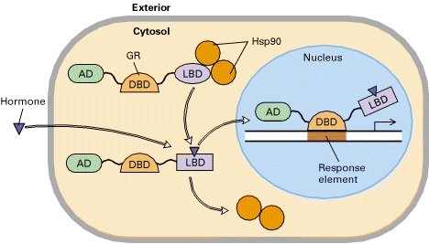

Slide 42
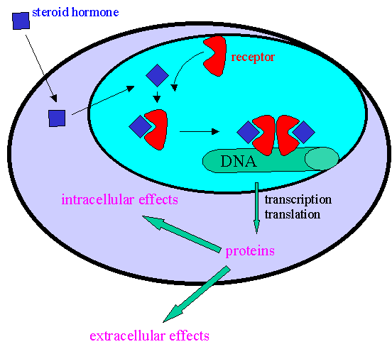

Slide 43
This DNA bound liganded receptor serves as a high affinity binding site for co-activator proteins.
This leads to accelerated gene transcription.

Slide 44
2. On the other hand hormones such as the thyroids and retinoids diffuse from the extracellular fluid across the membrane and go directly into the nucleus.
In this case the cognate receptor is already bound to HRE, in this case called TRE.

Slide 45
But this DNA bound receptor fails to activate transcription because it exists in complex with a co-repressor.
This receptor – co-repressor complex serves as an active repressor of gene transcription.
The association of ligand with these receptors result in the dissociation of the co-repressor.

Slide 46
When the ligand binds to the receptor it results in the dissociation of co repressor.
The liganded receptor is now capable of binding co activators, leading to gene transcription.

Slide 47
The liganded receptor is now capable of binding one or more co activators, and this causes activation of gene transcription.

Slide 48
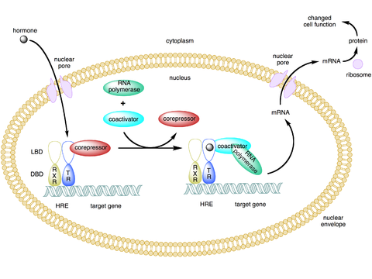

Slide 49
GROUP II HORMONES
Many hormones are water soluble, have no transport proteins and therefore has got a short plasma half life, and they initiate a response by binding to a receptor located in the plasma membrane.
Their mechanism of action is described in terms of intracellular signal they generate.

Slide 50
These signals include cAMP, cGMP, Ca and phosphatidylinositides.
These molecules are termed as second messengers and their synthesis is triggered by the presence of primary hormone binding to its receptor.
These messengers may affect gene transcription and other biologic processes.

Slide 51
G-Protein Coupled Receptors
Many of the group II hormones bind to receptors that couple to effectors through a GTP- binding protein intermediary.
These receptors have seven membrane spanning domains.
Members of this class which signal through G- proteins are called, G-protein-coupled receptors.
It is the largest family of cell surface receptors.

Slide 52
Components:
Seven membrane spaning domains
G- protein complex has α, β, γ subunits.
In inactive form is GDP bound form and is not associated with the receptor.
This group is attached to the plasma membrane through Prenylation on the β, γ subunits.

Slide 53
On binding of the hormone to the receptor, a conformational change in the receptor occurs.
G-protein complex is activated.
This cause the binding of GTP in exchange of GDP..
This binding occurs on the α subunit and, β γ subunits dissociate from it.

Slide 54
α subunit binds to and activate the effector.
Effector can be adenylyl cyclase, Ca, Na, or Cl or K channels, Phospholipase, or cGMP phosphodiestrase.

Slide 55
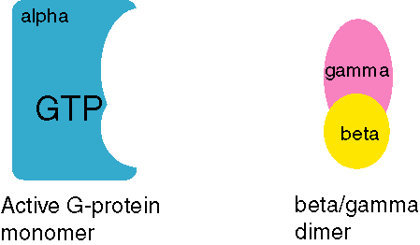

Slide 56
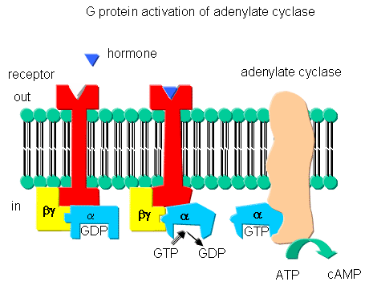

Slide 57
cAMP Intracellular Signal
cAMP was the first signal that was identified in mammalian cells.
Different Peptide hormones can either stimulate or inhibit the production of cAMP from adenylyl cyclase.

Slide 58
It has got a Catalytic molecule.
Each consists of a receptor R (Rs & Ri).
And a regulatory molecule G (Gs & Gi)
The regulatory complex(G) is composed of αβγ subunit.
α subunit differs in both Gs & Gi.

Slide 59
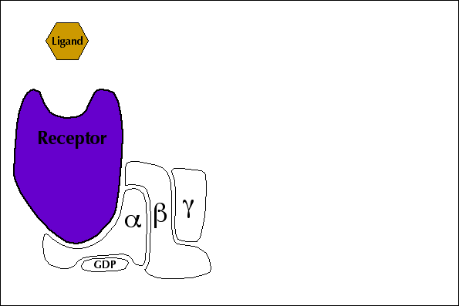

Slide 60
The hormone binds to Rs or Ri and results in receptor mediated activation of G, which entails the binding of GTP on α subunit.
αs protein has intrinsic GTPase activity.
So the active form αs – GTP is inactivated .
Again the trimeric Gs complex(αβγ) is formed.

Slide 61
On the other hand αi-GTP inhibit adenylyl cyclase by binding it.
This lowers the concentration of cAMP.
The action of cAMP is to mainly activate some of the protein kinases.
In eukaryotic cells cAMP binds to a protein kinase called Protein Kinase A.

Slide 62
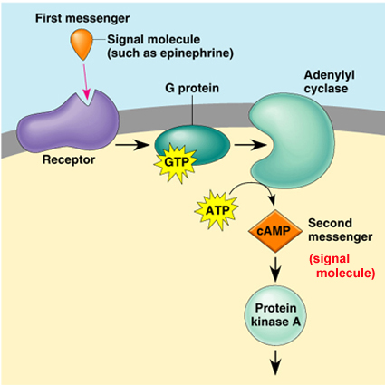

Slide 63
PKA is a heterotetrameric molecule and consists of two regulatory subunits and two catalytic subunits.
4cAMP+ R₂C₂↔ R₂.(4cAMP)+ 2C
R₂C₂ is not active catalytically, but the C unit is active.
The active C unit catalyzes the transfer of γ phosphate of ATP to a serine or threonine residue in a variety of proteins.

Slide 64
Phosphatases remove this phosphate and terminate the physiologic response.
Phosphodiestrase can also terminate this action by converting cAMP to 5’-AMP.
Inhibitors of phosphodiesterase like caffeine, which is a methylated xanthine derivative, increase the concentration of cAMP and prolongs the action of hormones.

Slide 65
cGMP Intracellular Signal
cGMP is made from GTP by the enzyme gaunylyl cyclase.
Atrial natriuretic peptide and nitric oxide function through this Signal.
These are potent vasodilators.
Inhibitors of cGMP phosphodiestrase is sildenafil (Viagra).

