Slide 1
HEMOGLOBIN
DR AMINA TARIQ
BIOCHEMISTRY

Slide 2
HEME PROTEINS
These are a group of specialized proteins that contain heme and globin.
Heme is the prosthetic part and globin is the protein part.
97% is the globin part and the rest 3% is the heme part.

Slide 3
GLOBULAR HEME PROTEINS
Role of heme group is dictated by the environment.
Examples:
a. Cytochromes
b. Catalase
c. Hemoglobin
d. Myoglobin

Slide 4
HEMOGLOBIN
Hemoglobin is the protein that carries oxygen from the lungs to the tissues and carries carbon dioxide from the tissues back to the lungs..

Slide 5
The oxygen-carrying protein hemoglobin was discovered in 1840.

Slide 6
Hemoglobin's reversible oxygenation was described a few years later.
In 1959 Max Perutz determined the molecular structure of hemoglobin by X-ray crystallography. This work resulted in his sharing with John Kendrew the 1962 Nobel Prize in Chemistry.

Slide 7
STRUCTURE OF HEMOGLOBIN
Hemoglobin molecule consists of four polypeptide chains:
Two alpha chains, each with 141 amino acids and
Two beta chains, each with 146 amino acids.

Slide 8
Both the α and β globin chains contain primarily α helix secondary structure with no β sheets.

Slide 9
Each α or β globin chain folds into 8 α - helical segments (A-H) which, in turn, fold to form globular tertiary structures.
The folded helices form a pocket that holds the working part of each chain, the heme.

Slide 10
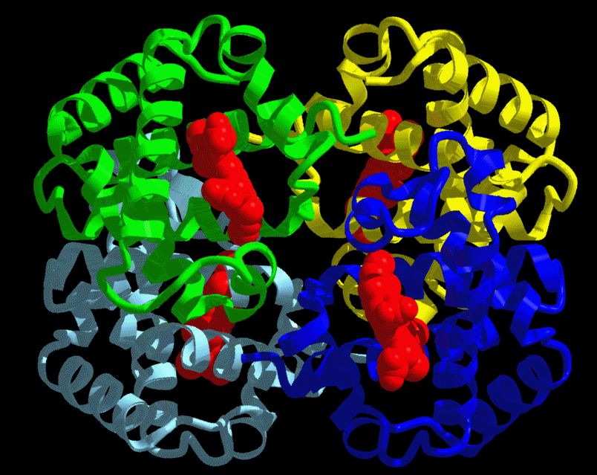

Slide 11
The alpha and beta subunits of the globin chains exist in two dimers which are bonded together strongly.
Thus Hb is a tetramer composed of two identical dimers (αβ)₁ (αβ)₂ .

Slide 12
Quaternary structure of Hb
Polypeptides of α and β chain are held together by hydrophobic interactions.
Polypeptides between αβ dimers are held by ionic and hydrogen bonds.

Slide 13
PORPHYRIN METABOLISM
Porphyrins are cyclic compounds.
They bind metal ions, mostly Fe²⁺ or Fe ³⁺
The most prevalent metalloporphyrin in humans is Heme.
Heme is the prosthetic group for myoglobin, hemoglobin , cytochromes, catalase and tryptophan pyrrolase.

Slide 14
Heme consists of one ferrous ion in the center of a tetrapyrrole ring of protoporphyrin IX.

Slide 15
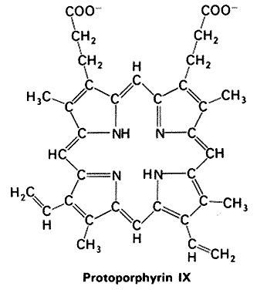

Slide 16
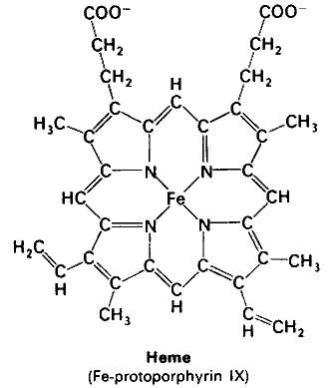

Slide 17
Structure of Porphyrins
These are cyclic molecules.
Formed by the linkage of four tetrapyrrole rings, through methenyl bridges.
Structural Features:
1. Side chains- All the porphyrins vary in the nature of their side chains that are attached to their pyrrole rings.e.g.

Slide 18
Uroporphyrin- acetate and propionate
Coproporphyrin- methyl and propionate
Protoporphyrin IX- vinyl, methyl and propionate

Slide 19
2. The side chains can be ordered in four different ways, designated as I- IV.
Only Type III porphyrins are physiologically important. They have an asymmetric distribution. e.g.
AP, AP,AP, AP- Type I
AP, AP, PA, AP- Type III

Slide 20
3. Porphyrinogens : These are the precursors of porphyrins. They are colorless.

Slide 21
STEPS OF SYNTHESIS OF HEME
Major Sites:
Liver (heme proteins- cytochromes)(fluctuating)
Bone marrow (RBC)(constant).
Initial and the last three steps occur in the mitochondria
Intermediate steps in the cytosol.
RBC’s have no mitochondria, unable to synthesize heme.

Slide 22
Glycine + succinyl CoA
δ-aminolevulinic acid(ALA)
Enzyme: Mitochondrial enzyme
δ-aminolevulinate synthase
− Hemin, Heme

Slide 23
Reaction requires pyridoxal phosphate as a co- enzyme.
It is the rate limiting step
Inhibited by end product hemin(heme).
Drugs such as phenobarbitol, griseofulvin or hydantoin- increase the activity of ALA synthase.

Slide 24
These drugs are metabolized by microsomal cytochromes

Slide 25
δ-aminolevulinic acid(ALA) (2 mol condense)
Porphobilinogen
Enzyme: δ-aminolevulinic acid dehydratase
− Lead

Slide 26
Porphobilinogen( 4 molecules condense)
Hydroxymethylbilane
Enzyme: Hydroxymethylbilane synthase

Slide 27
Hydroxymethylbilane (ring closure and isomerization)
Uroporphyrinogen III
Enzyme- Uroporphyrinogen III synthase

Slide 28
Uroporphyrinogen III
Coporphyrinogens III
Enzyme: Uroporphyrinogen decarboxylase

Slide 29
Coporphyrinogens III
Protoporphyrinogen IX
Enzyme: Coporphyrinogens Oxidase

Slide 30
Protoporphyrinogen IX
Protoporphyrin IX
Enzyme: Protoporphyrinogen oxidase

Slide 31
Protoporphyrin IX
Heme
Enzyme: Ferrochelatase

Slide 32
Types in humans
In the embryo:
Gower 1 (ζ₂ε₂)
Gower 2 (α₂ε₂)
Hemoglobin Portland (ζ₂γ₂)

Slide 33
In the fetus:
Hemoglobin F (α₂γ₂)

Slide 34
In adults:
Hemoglobin A (α₂β₂) - The most common with a normal amount over 95%
Hemoglobin A₂ (α₂δ₂) - δ chain synthesis begins late in the third trimester and in adults, it has a normal range of 1.5-3.5%
Hemoglobin F (α₂γ₂) - In adults Hemoglobin F is restricted to a limited population of red cells called F-cells. However, the level of Hb F can be elevated in persons with sickle-cell disease.

Slide 35
Hemoglobin C (α₂β^{C}₂) - Another variant due to a variation in the β-chain gene. This variant causes a mild chronic hemolytic anemia.
Hemoglobin E (α₂β^{E}₂) - Another variant due to a variation in the β-chain gene. This variant causes a mild chronic hemolytic anemia.

Slide 36
Variant forms which cause disease:
Hemoglobin H (β₄) - A variant form of hemoglobin, formed by a tetramer of β chains, which may be present in variants of α thalassemia.
Hemoglobin Barts (γ₄) - A variant form of hemoglobin, formed by a tetramer of γ chains, which may be present in variants of α thalassemia.

Slide 37
Hemoglobin S (α₂β^{S}₂) - A variant form of hemoglobin found in people with sickle cell disease. There is a variation in the β-chain gene, causing a change in the properties of hemoglobin which results in sickling of red blood cells.

Slide 38
Hemoglobin AS - A heterozygous form causing Sickle cell trait with one adult gene and one sickle cell disease gene
Hemoglobin SC disease - Another heterozygous form with one sickle gene and another encoding Hemoglobin C.

Slide 39
In diabetics whose glucose usually runs high, the percent Hb A_{1c} also runs high. Because of the slow rate of Hb A combination with glucose, the Hb A_{1c} percentage is representative of glucose level in the blood averaged over a longer time (the half-life of red blood cells, which is typically 50–55 days).

Slide 40
The levels of glycosylated hemoglobin are tested to monitor the long-term control of the chronic disease of type 2 diabetes mellitus (Type2 DM). Poor control of Type2 DM results in high levels of glycosylated hemoglobin in the red blood cells.

Slide 41
The normal reference range is approximately 4 %–5.9 %. Though difficult to obtain, values less than 7 % are recommended for people with Type 2 DM. Levels greater than 9 % are associated with poor control of diabetes and levels greater than 12 % are associated with very poor control.

Slide 42
Diabetics who keep their glycosylated hemoglobin levels close to 7 % have a much better chance of avoiding the complications that can sometimes accompany diabetes (than those whose levels are 8 % or higher).

Slide 43
Diagnostic uses
Hemoglobin concentration measurement is among the most commonly performed blood tests, usually as part of a complete blood count.

Slide 44
Learning Resources
Lippincott's Biochemistry
Lecture notes

